Slide 1
Personal Journey
Chéyo Jiménez, MSE

Slide 2
~12 years as of 2021
Young professional figuring how to get paid for doing what I love
Our professional life may take different paths but the journey is the same

Slide 3
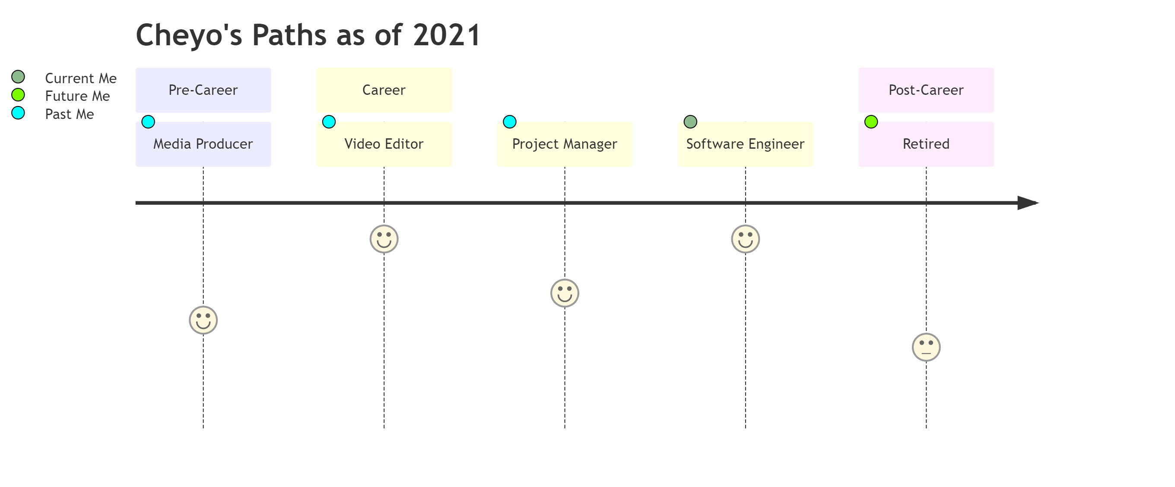
Notes:
Not included here are college jobs that would not qualify. For example, working at as a package loader motivated me to not want to do that as a career. The same goes for summer helping family with home construction projects.

Slide 4

Video Editor at NonProfit
Notes:
Motivation: Helping people in need and getting other people to help. Different than most traditional non profits.
Ability: Creating digital artifacts to get more people involved in helping people.
Learnings: How to work hard (Ability). Aligned to the mission (Motivation). Leadership and confidence (Motivation)

Slide 5

Project Manager at Portable Buildings Company
Notes:
Motivation: I was creating less and less digital content that I thought it might be better for me to switch career where they may be better pay.
Ability: Work hard. Leadership and confidence. Support sales people to sell more structures.
Learnings: International Travel is overrated. A company (where you work) should not be part of your identity. Money as a primary motivation did not work for me.

Slide 6

Software Engineer at Tech Company
Notes:
Motivation: I love to code.
Ability: Create clarity from ambiguity. All previous abilities.
Learnings: More money doesn’t remove career angst. Constant Mastery > arriving. Enjoy the journey > getting to a destination.

